Slide 1
Our Story Begins….

Slide 2
District/Board Presentation Report 2018-19

Slide 3
Did you know?

Slide 4
TEACHERS WERE:
provided 500 hours of professional development over the past five years.
provided 30 transcripted credits in district over the past five years.
presented revised color coded curriculum maps with "I Can" statements.
provided technology/instructional coaches and interventionists.
given a new math curriculum in 2017-18.

Slide 5
STUDENTS WERE:
found outpacing the state in 11 out of 14 areas of growth on ISAT.
accountable to standards on their report cards grades K-5.
found achieving their highest scores ever on the Math ISAT in 3rd, 4th, 5th, 6th, and 7th grades.
exited from the EL program based off their WIDA Access scores.
given Advanced Opportunities and our first student graduated with an Associates degree.
able to participate in the first Bilingual Medical Transcripting Program where 14 students certified and gained 16 college credits.

Slide 6
ISAT ACHIEVEMENTS

Slide 7
ISAT ACHIEVEMENTS
67.5% of 5th grade students from two schools scored proficient in Science. (the state average is 64%)
6 grades out of 9 increased their ELA overall proficiency score.
this year 4th, 5th, and 6th grades had their highest ELA proficiency scores ever.

Slide 8
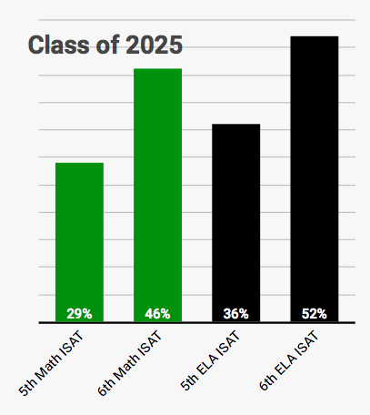
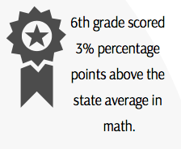
ISAT ACHIEVEMENTS

Slide 9
WHAT ARE WE DOING?
Teaching math curriculum to fidelity.
Utilizing ISAT Interim Block Assessments.
Improving our testing practices.

Slide 10
ISIP ACHIEVEMENTS

Slide 11
ISIP ACHIEVEMENTS
Kindergarten students increased by 108% in Tier 1.
1st grade students increased by 100% in Tier 1.
2nd grade students increased by 17% in Tier 1.
3rd grade students increased by 22% in Tier 1.

Slide 12
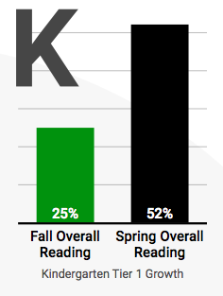
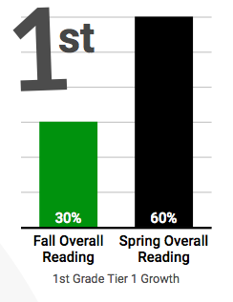
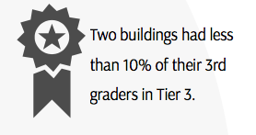
ISIP ACHIEVEMENTS

Slide 13
WHAT ARE WE DOING?
Utilizing comprehensive data to form skill-based ELA interventions.
Familiarizing students with new testing format of IRI with monthly access.
Offering all day kindergarten.

Slide 14
easyCBM ACHIEVEMENTS

Slide 15
easyCBM ACHIEVEMENTS
Kindergartners from three schools scored over 92% proficient in math.
Third graders from three schools scored over 88% proficient in math.
Second graders from three schools scored over 75% proficient in ELA.
All 5th grade classes increased overall proficiency in math.
All 4th grade classes increased comprehension proficiency.

Slide 16
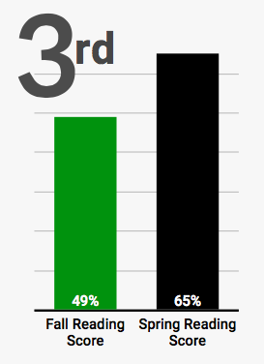
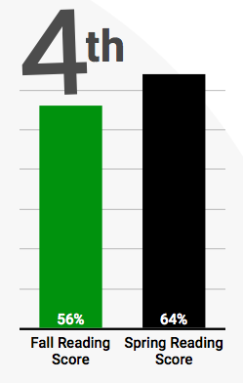
easyCBM ACHIEVEMENTS

Slide 17
WHAT ARE WE DOING?
Increasing rigor by focusing on higher level skills.
Addressing skill deficits and progress monitoring.
Evaluating based on 50%ile by grade levels.

Slide 18
Challenges
Getting accustomed to all of the changes that were given to teachers.
Teaching/knowing standards at deeper levels of knowledge.
Comprehensive writing in all content areas.
The increase of alternate route to certification teachers.
Increasing the attendance to district professional development classes.
Reading curriculum is outdated.
Increase of behavioral challenges in students.

Slide 19
Next Steps
Strengthen Tier One instruction districtwide through PD on standards and classroom management.
Utilize protocol for examining data.
Continue to improve student and teacher motivation for growth mindset.
All new teachers receive specialized PD.
Pilot new reading curriculum to prepare for adoption.
All content areas focus on writing and calibration of assessing writing.
Full-time interventionist placed at each elementary school.

Slide 20
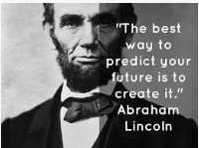
Sequel coming Spring 2020!

